Slide 1
Cryptography Understanding
Cryptography Terminology
Application
IVI LD1
Cyber Security Part

Slide 2
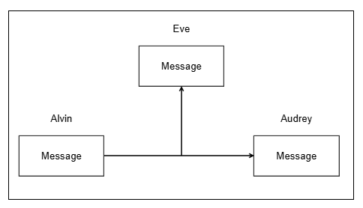
I. Plaintext
Definition | Advantages | Disadvantages | Example
Plaintext (or cleartext): Is the message or data in its original. Can be read, understood directly by human, or processed by computers without decoding. | Easy to read and understand. Simple to process and analyze. Fast transmission. | Not secure: Easily intercepted during transmission. Easily to read and modify.
Alvin – Sender.
Audrey – Receiver.
Eve – Eavesdropper: She can intercept and read the plaintext message.
Notes:
First, I would like to introduce basic term of cryptography.
To begin with, we will explore about Plaintext and Ciphertext.

Slide 3
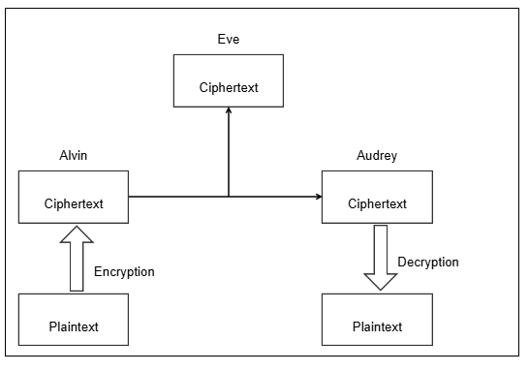
II. Ciphertext
Definition | Advantages | Disadvantages | Example
Ciphertext: Is the encrypted form of plaintext Unreadable without the correct decryption key. | Secure: Protect the message from unauthorized reading. Ensure the message is received without modification. | Require decryption key. Consumes a lot of processing resources. Complexity. Potential delays.
Alvin:
Create Plaintext → Encryption Plaintext to Ciphertext → Sent Ciphertext to Audrey.
Audrey:
Receive Ciphertext from Alvin → Decryption Ciphertext to Plaintext → Read Plaintext.
Eve: Can steal the message but she can’t understand message in Ciphertext form.

Slide 4
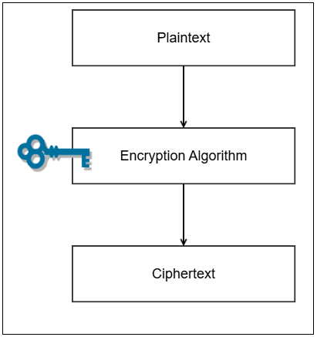
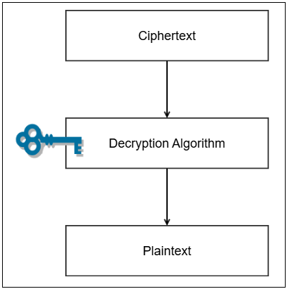
III. Encryption & Decryption
 | Definition | Function | Process
Encryption | Encryption is the process of converting plaintext into ciphertext using an encryption algorithm and a key. | Protect the information from unauthorized access.
Decryption | Decryption is the reverse process of encryption — converting ciphertext back into readable plaintext using a decryption algorithm and a key. | Convert information to understandable form (plaintext).

Slide 5
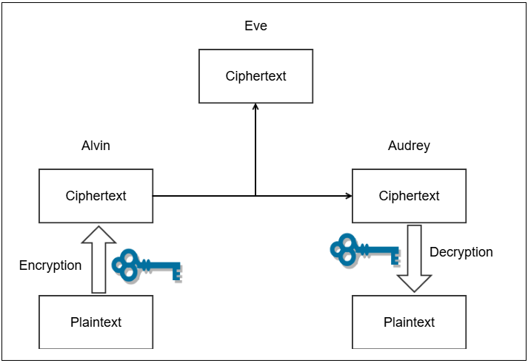
IV. Symmetric Key
Definition | Symmetric : Sender & Receiver use the same secret key. Symmetric key is a type of encryption where the same key is used for both encryption and decryption of data. Key can be created by the sender or receiver and given to the other.
Process
1. Alvin has Plaintext, he use Encryption Algorithm + Key convert Plaintext → Ciphertext.
2. Alvin send Ciphertext over the communication chanel to Audrey.
3. Audrey receive Ciphertext, she use Decryption Algorithm + Key convert Ciphertext → Plaintext.
4. Eve can steal data on the communication channel but doesn’t have the Key to convert ciphertext -> plaintext → she cannot understand the message Alvin sent to Audrey.

Slide 6
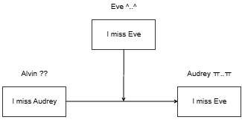
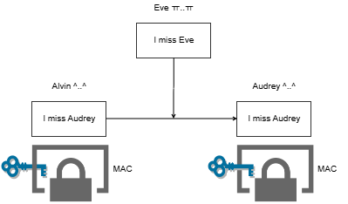
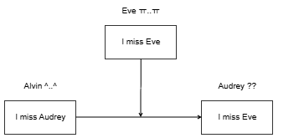

V. MAC (Message Authentication Code)
Definition | MAC (Message Authentication Code) is a short information used to verify the integrity and authenticity of a message. It is generated by applying a secret key & message: MAC = Algorithm(Key, Message). If even a single bit of the message changes, the MAC will also change → Detection of forgery, alteration, or content discrepancy MAC doesn’t encrypt or hide message.
Example
Without MAC:
Alvin send plaintext message to Audrey → Eve can steal message and modify it easily , then sent it to Audrey.
Audrey receives the altered message, but does not know it has been altered.
With MAC:
Alvin use Secret Key (was shared with Eve) and Plaintext message to generate MAC and send to Audrey.
Audrey received message and use same Secret Key to verify the MAC:
If Match she can she can be sure that the message is from Alvin and has not been modified.
If Mismatch the message is not from Alvin or has been modified (by Eve in this example).

Slide 7
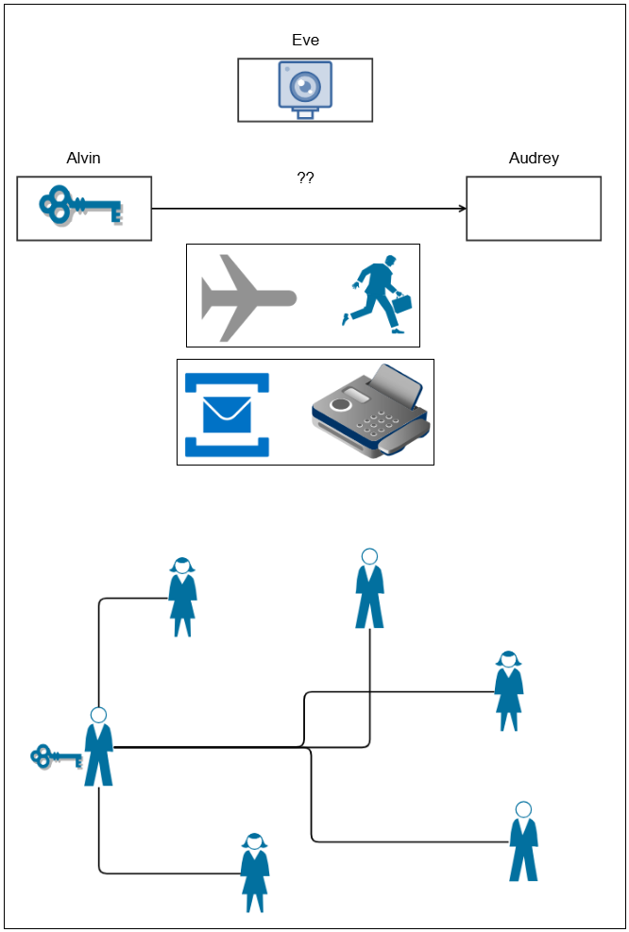
VI. Key Exchange Problem
How can Alvin securely send the Key to Audrey?
Physical
Digital
How can Alvin send Key to many people without them being able to read the messages Alvin sends to others?
Alvin

Slide 8
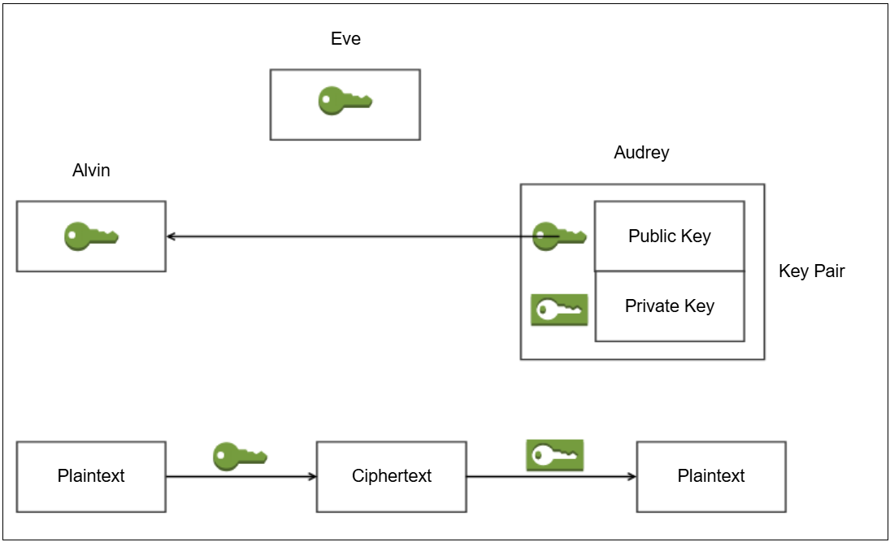
VII. Asymmetric Key
Definition | Asymmetric : Sender & Receiver use two different keys (Public key & Private key). Symmetric key is a type of encryption where Public key use for Encryption & Private key use for Decryption, Public & Private key is a Key pair. Key Pair created by Receiver.
Process
1. Generate Key pair
Audrey (Receiver) generates a Key pair that are mathematically linked together.
This key pair includes:
Public Key: Designed to be shared publicly.
Private Key: Must be kept absolutely secret.
2. Key Distribution
Audrey sends her Public Key to anyone who wants to contact her (Alvin).
The eavesdropper (Eve) can also easily get this Public Key. This is acceptable and by design.
3. Encryption
Alvin (Sender) has Plaintext.
He uses Audrey's Public Key to Encrypt the Plaintext -> Cipertext.
Alvin sent Ciphertext message to Audrey.
4. Decryption
The Ciphertext is sent over the network (Eve can intercept it).
Audrey receives the Ciphertext and uses her Private Key to Decrypt it.
The result is the recovery of the original Plaintext.
➔ Solving the Key Exchange Problem

Slide 9
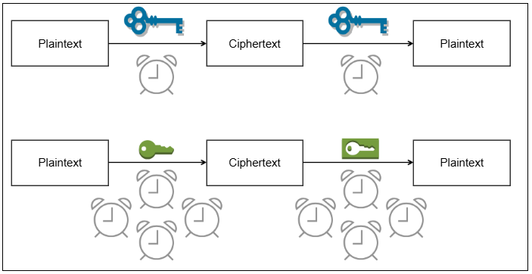
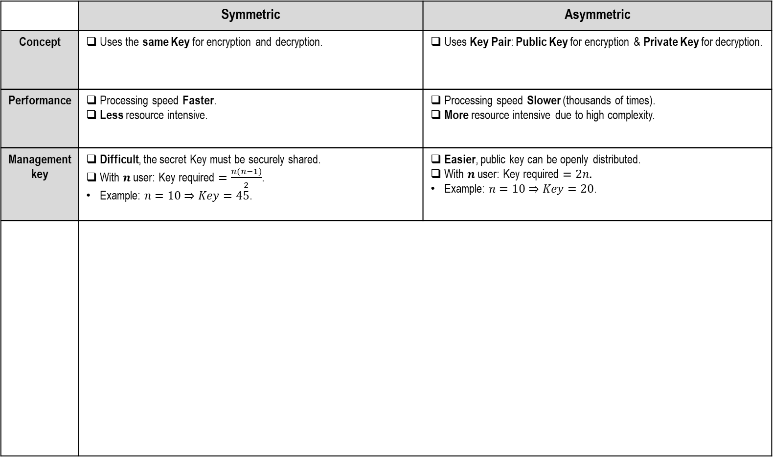
VIII. Symmetric vs. Asymmetric
 | Symmetric | Asymmetric
Concept | Uses the same Key for encryption and decryption. | Uses Key Pair: Public Key for encryption & Private Key for decryption.
Performance | Processing speed Faster. Less resource intensive. | Processing speed Slower (thousands of times). More resource intensive due to high complexity.
Management key | Difficult, the secret Key must be securely shared. With $n$ user: Key required $=\frac{n(n−1)}{2}$. Example: $n=10⇒Key=45$. | Easier, public key can be openly distributed. With $n$ user: Key required $=2n$. Example: $n=10⇒Key=20$.

Slide 10
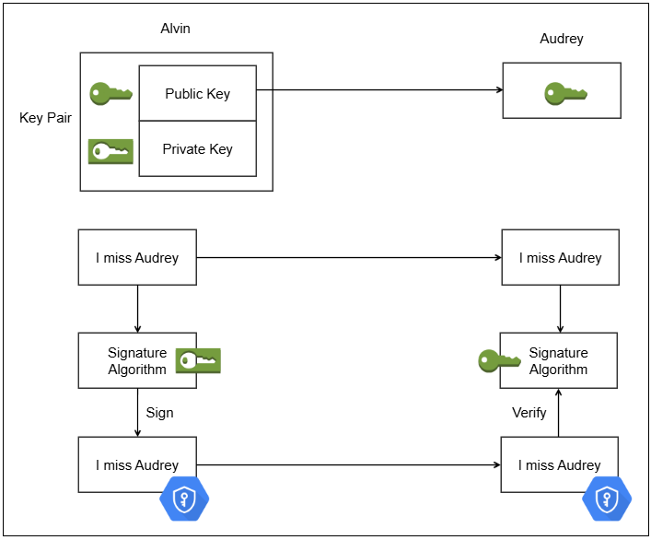
IX. Digital Signature
Definition | Digital signature is a cryptographic technique used to verify the authenticity, integrity, and non-repudiation of a digital message or document.
Process
1. Generate Key pair
Alvin generates Key pair.
Alvin sends his Public Key to Audrey (and anyone else).
2. Signing Process (Done by Alvin)
Alvin has original message ("I miss Audrey").
He uses his Private Key and a "Signature Algorithm" to create a Digital signature (the shield icon).
Alvin sends the original message (plaintext) & Digital signature to Audrey.
3. Verification Process (Done by Audrey)
Audrey receives the Message and the Digital signature.
She uses Alvin's Public Key and runs the "Signature Algorithm" in verification mode.
This algorithm checks whether the signature matches the message.
If it matches: Audrey can trust that the message came from Alvin and that the content has not been altered.
If Eve (the attacker) tries to alter the message in transit, the signature will no longer be valid -> Audrey's verification will fail.

Slide 11
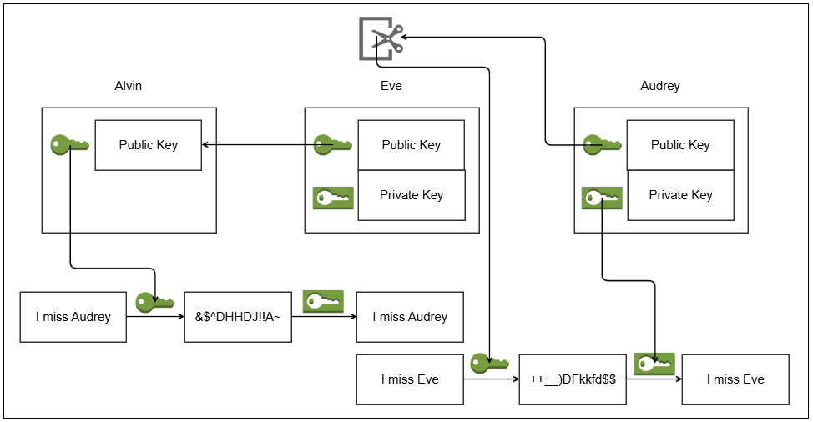
X. Public Key Owner Problem
Attack Scenario
1. Phase 1: Key Exchange
Alvin requests Audrey's Public Key.
Eve (scissors icon) intercepts the connection.
Eve sends HER Public Key to Alvin, but pretends it is Audrey's.
At the same time, Eve gets Audrey's real Public Key.
Result: Alvin now holds Eve's key (thought it was Audrey's). Eve now holds Audrey's key.
2. Phase 2: Attack
Alvin -> Eve: Alvin writes "I miss Audrey". He uses the public key (which he thought was Audrey's) to encrypt. Since this is actually Eve's key, the ciphertext (&$*DHHDJIIA~) is sent.
Eve (Decryption): Eve intercepts the ciphertext. She uses her Private Key to decrypt -> Eve reads the message "I miss Audrey". (Confidentiality is broken).
Eve (Re-encryption): Eve changes the content to "I miss Eve". Then, she uses Audrey's real Public Key (which she has) to re-encrypt this message.
Eve -> Audrey: Eve sends the new ciphertext (++_)DFkkfd$$) to Audrey.
Audrey (Decryption): Audrey receives the ciphertext and uses her real Private Key to decrypt it. She receives the message "I miss Eve" and believes it came from Alvin. (Integrity and Authentication are broken).
➔ Conclusion: A "Public Key" is simply a string of data. It contains no information to prove who it belongs to. Alvin has no way to verify that the key he receives actually belongs to Audrey.

Slide 12
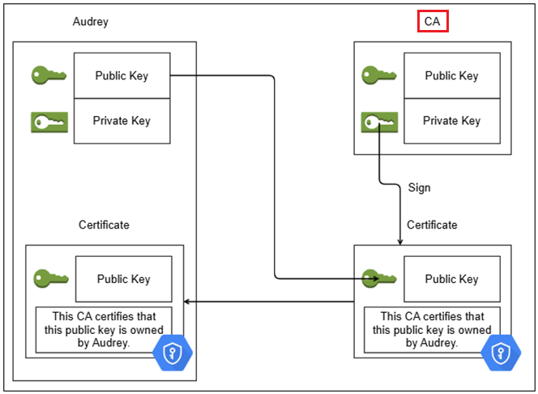
XI. PKI (Public Key Infrastructure)
Problem Solve | New Role: Introduce a trusted third party called a Certificate Authority (CA). The CA itself has a key pair (Public/Private Key). Requesting a Certificate: Audrey sends her Public Key (along with proof of identity, not shown in the image) to the CA. Signing Process: The CA verifies Audrey's identity (this step is very important). The CA creates a new document called a Certificate. This certificate contains Audrey's Public Key and her identification information (e.g., "This CA certifies that this public key is owned by Audrey"). The CA uses its own Private Key to sign the entire certificate.
Process
1. When Alvin wants to communicate, Audrey sends him her Certificate (instead of just sending the bare Public Key).
2. Alvin receives the Certificate. Alvin's system must have the CA's Public Key installed (called the Root Certificate and is trusted by default).
3. Alvin uses the CA's Public Key to verify the signature on Audrey's Certificate.
4. If the signature is valid, Alvin can be 100% confident that the Public Key inside the Certificate really belongs to Audrey. He has authenticated the owner, thereby stopping the attack.

Slide 13
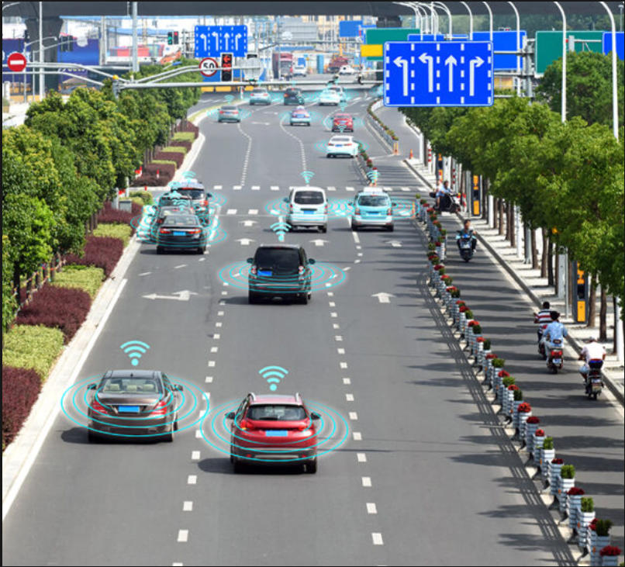
XII. Practical Applications
1. OTA update
Digital Signature
PKI
2. Data in Transit protection
Hybrid Cryptography (Symmetric & Asymmetric)
3. In – Vehicle Communication protection
MAC
4. Data at Rest protection
Symmetric Key
Notes:
Mac NÀY KHÁC GÌ MAC của bluetooth

Slide 14
XII. Practical Applications
1. OTA update
 | Digital Signature | PKI
Objectives | Ensure software integrity and authenticity. | : Prevent Man-in-the-Middle (MITM) attacks during the update download.
Application | The OEM (LG/Manufacturer) Signs the OTA update package using its Private Key. The IVI unit, which has the OEM's Public Key pre-installed, Verifies this signature. The update is only installed if the verification succeeds. | The IVI connects to the OTA server via TLS (HTTPS). The IVI uses its built-in trusted PKI (Root CAs) to authenticate the server's Certificate, ensuring it is communicating with the genuine OEM server and not a malicious imposter.

Slide 15
XII. Practical Applications
2. Data in Transit protection
 | Hybrid Cryptography (Symmetric & Asymmetric)
Objectives | Secure (encrypt) data transmitted over untrusted networks (Wi-Fi, 5G, Bluetooth).
Application | The IVI and the OTA server (or user's phone) use Asymmetric Cryptography (slow) to securely negotiate a temporary session key. They then use Symmetric Cryptography (e.g., AES, which is fast) with that session key to encrypt/decrypt the entire data stream.

Slide 16
XII. Practical Applications
3. In Vehicle Communication
 | MAC (Message Authentication Code)
Objectives | : Ensure the integrity and authenticity of critical messages on internal networks (e.g., CAN bus).
Application | Used in protocols like SecOC (Secure On-Board Communication), which is based on MACs (typically CMAC). The IVI and a Central Gateway (CGW) share a secret key (symmetric) to sign and verify messages, preventing CAN spoofing attacks.

Slide 17
XII. Practical Applications
4. Data at Rest protection
 | Symmetric Key
Objectives | Protect user-private data (contacts, location history) stored on the IVI's flash memory.
Application | User data is encrypted using a symmetric key (e.g., AES). This key can be protected by or derived from the user's credentials or a hardware security module (HSM/TPM).

Slide 18
XV. Application in LGEVH
Key management in LGE use Asymmetric key with PKI system.

Slide 19
- Thank you -

Slide 20
I. Plaintext

Slide 21
II. Ciphertext

Slide 22
IV. Symmetric Key
1. Alvin has Plaintext, he use Encryption Algorithm + Key convert Plaintext → Ciphertext.
2. Alvin send Ciphertext over the communication chanel to Audrey.
3. Audrey receive Ciphertext, she use Decryption Algorithm + Key convert Ciphertext → Plaintext.
4. Eve can steal data on the communication channel but doesn’t have the Key to convert ciphertext -> plaintext → she cannot understand the message Alvin sent to Audrey.

Slide 23
V. MAC

Slide 24
VII. Asymmetric Key
1.Generate Key pair
Audrey (Receiver) generates a Key pair that are mathematically linked together.
This key pair includes:
Public Key: Designed to be shared publicly.
Private Key: Must be kept absolutely secret.
2. Key Distribution
Audrey sends her Public Key to anyone who wants to contact her (Alvin).
The eavesdropper (Eve) can also easily get this Public Key. This is acceptable and by design.
3. Encryption
Alvin (Sender) has Plaintext.
He uses Audrey's Public Key to Encrypt the Plaintext -> Cipertext.
Alvin sent Ciphertext message to Audrey.
4. Decryption
The Ciphertext is sent over the network (Eve can intercept it).
Audrey receives the Ciphertext and uses her Private Key to Decrypt it.
The result is the recovery of the original Plaintext.
➔ Solving the Key Exchange Problem

Slide 25
IX. Digital Signature
1. Generate Key pair
Alvin generates Key pair.
Alvin sends his Public Key to Audrey (and anyone else).
2. Signing Process (Done by Alvin)
Alvin has original message ("I miss Audrey").
He uses his Private Key and a "Signature Algorithm" to create a Digital signature (the shield icon).
Alvin sends the original message (plaintext) & Digital signature to Audrey.
3. Verification Process (Done by Audrey)
Audrey receives the Message and the Digital signature.
She uses Alvin's Public Key and runs the "Signature Algorithm" in verification mode.
This algorithm checks whether the signature matches the message.
If it matches: Audrey can trust that the message came from Alvin and that the content has not been altered.
If Eve (the attacker) tries to alter the message in transit, the signature will no longer be valid -> Audrey's verification will fail.

Slide 26
X. Public Key Owner Problem
1. Phase 1: Key Exchange
Alvin requests Audrey's Public Key.
Eve (scissors icon) intercepts the connection.
Eve sends HER Public Key to Alvin, but pretends it is Audrey's.
At the same time, Eve gets Audrey's real Public Key.
Result: Alvin now holds Eve's key (thought it was Audrey's). Eve now holds Audrey's key.
2. Phase 2: Attack
Alvin -> Eve: Alvin writes "I miss Audrey". He uses the public key (which he thought was Audrey's) to encrypt. Since this is actually Eve's key, the ciphertext (&$*DHHDJIIA~) is sent.
Eve (Decryption): Eve intercepts the ciphertext. She uses her Private Key to decrypt -> Eve reads the message "I miss Audrey". (Confidentiality is broken).
Eve (Re-encryption): Eve changes the content to "I miss Eve". Then, she uses Audrey's real Public Key (which she has) to re-encrypt this message.
Eve -> Audrey: Eve sends the new ciphertext (++_)DFkkfd$$) to Audrey.
Audrey (Decryption): Audrey receives the ciphertext and uses her real Private Key to decrypt it. She receives the message "I miss Eve" and believes it came from Alvin. (Integrity and Authentication are broken).
➔ Conclusion: A "Public Key" is simply a string of data. It contains no information to prove who it belongs to. Alvin has no way to verify that the key he receives actually belongs to Audrey.

Slide 27
XI. PKI
1. When Alvin wants to communicate, Audrey sends him her Certificate (instead of just sending the bare Public Key).
2. Alvin receives the Certificate. Alvin's system must have the CA's Public Key installed (called the Root Certificate and is trusted by default).
3. Alvin uses the CA's Public Key to verify the signature on Audrey's Certificate.
4. If the signature is valid, Alvin can be 100% confident that the Public Key inside the Certificate really belongs to Audrey. He has authenticated the owner, thereby stopping the attack.

